Slide 1
SOFTWARE DESIGN
Software design is a process to transform user requirements into some suitable form, which helps the programmer in software coding and implementation.
IEEE defines software design as 'both a process of defining, the architecture, components, interfaces, and other characteristics of a system or component and the result of that process.'

Slide 2
Principles
Software design should correspond to the analysis model
Choose the right programming paradigm
Software design should be uniform and integrated
Software design should be flexible
Software design should ensure minimal conceptual (semantic) errors
Software design should be structured to degrade gently
Software design should represent correspondence between the software and real-world problem

Slide 3
Design Fundamental
Abstraction
Architecture
Patterns
Modularity
Information Hiding
Refinement
Refactoring

Slide 4
ABSTRACTION
IEEE defines abstraction as 'a view of a problem that extracts the essential information relevant to a particular purpose and ignores the remainder of the information.'

Slide 5
Functional abstraction
Data abstraction
Control abstraction

Slide 6
Architecture
Software architecture refers to the structure of the system, which is composed of various components of a program/ system, the attributes (properties) of those components and the relationship amongst them.
Highlights early design decisions, which have great impact on the software engineering activities (like coding and testing) that follow the design phase
Creates intellectual models of how the system is organized into components and how these components interact with each other.

Slide 7
Patterns
A pattern provides a description of the solution to a recurring design problem of some specific domain in such a way that the solution can be used again and again.

Slide 8
Modularity
Modularity is achieved by dividing the software into uniquely named and addressable components, which are also known as modules

Slide 9
Information Hiding
Modules should be specified and designed in such a way that the data structures and processing details of one module are not accessible to other modules
They pass only that much information to each other, which is required to accomplish the software functions

Slide 10
IEEE defines information hiding as 'the technique of encapsulating software design decisions in modules in such a way that the module's interfaces reveal as little as possible about the module's inner workings; thus each module is a 'black box' to the other modules in the system

Slide 11
Refinement
Stepwise refinement is a top-down design strategy used for decomposing a system from a high level of abstraction into a more detailed level (lower level) of abstraction

Slide 12
Refactoring
Refactoring is an important design activity that reduces the complexity of module design keeping its behavior or function unchanged
Refactoring can be defined as a process of modifying a software system to improve the internal structure of design without changing its external behavior

Slide 13
Architecture & User Interface Design

Slide 14
Definitions
The software architecture of a program or computing system is the structure or structures of the system which comprise
The software components
The externally visible properties of those components
The relationships among the components

Slide 15
Software architectural design represents the structure of the data and program components that are required to build a computer-based system
An architectural design model is transferable
It can be applied to the design of other systems
It represents a set of abstractions that enable software engineers to describe architecture in predictable ways

Slide 16
Architectural Design Process
Basic Steps
Creation of the data design
Derivation of one or more representations of the architectural structure of the system
Analysis of alternative architectural styles to choose the one best suited to customer requirements and quality attributes
Elaboration of the architecture based on the selected architectural style

Slide 17
A database designer creates the data architecture for a system to represent the data components
A system architect selects an appropriate architectural style derived during system engineering and software requirements analysis

Slide 18
Architectural Elements
The architectural model is derived from below sources:
information about the application domain for the software to be built;
specific requirements model elements such as data flow diagrams or analysis classes, their relationships and collaborations for the problem at hand.

Slide 19
Software Architecture
“The software architecture of a program or computing system is the structure or structures of the system, which comprise the software components, the externally visible properties of those components, and the relationships among them.”
It is not operational software but it is representation that enables software engineer to
Analyze the effectiveness of design in meeting its stated requirement.
consider architectural alternatives at a stage when making design changes is still relatively easy,
reduce the risks associated with the construction of the software.

Slide 20
Importance of Software Architecture
Representations of software architecture are an enabler for communication between all parties (stakeholders) interested in the development
Architecture highlights early design decisions that will have a profound impact on all software engineering work that follows.
Architecture “constitutes a relatively small, intellectually graspable model of how the system is structured and how its components work together”

Slide 21
Data Design
The structure of data has always been an important part of software design.
Component level – the design of data structures and the associated algorithms required to manipulate them is essential to the creation of high-quality applications.
Application level – the translation of a data model into a database design

Slide 22
Data design at the component level
Component level focuses on the representation of data structures that are directly accessed by one or more software components.
Principles are applicable to data design
The systematic analysis principles applied to function and behavior should also be applied to data.
All data structures and the operations to be performed on each should be identified.
A data dictionary should be established and used to define both data and program design (operations)
Low-level data design decisions should be deferred until late in the design process.

Slide 23
The representation of data structure should be known only to those modules that must make direct use of the data contained within the structure.
A library of useful data structures and the operations that may be applied to them should be developed.
A software design and programming language should support the specification and realization of abstract data types.

Slide 24
User Interface Design

Slide 25
User Interface Design
User interface design creates an effective communication medium between a human and a computer.
Following a set of interface design principles, design identifies interface objects and actions and then creates a screen layout that forms the basis for a user interface prototype.

Slide 26
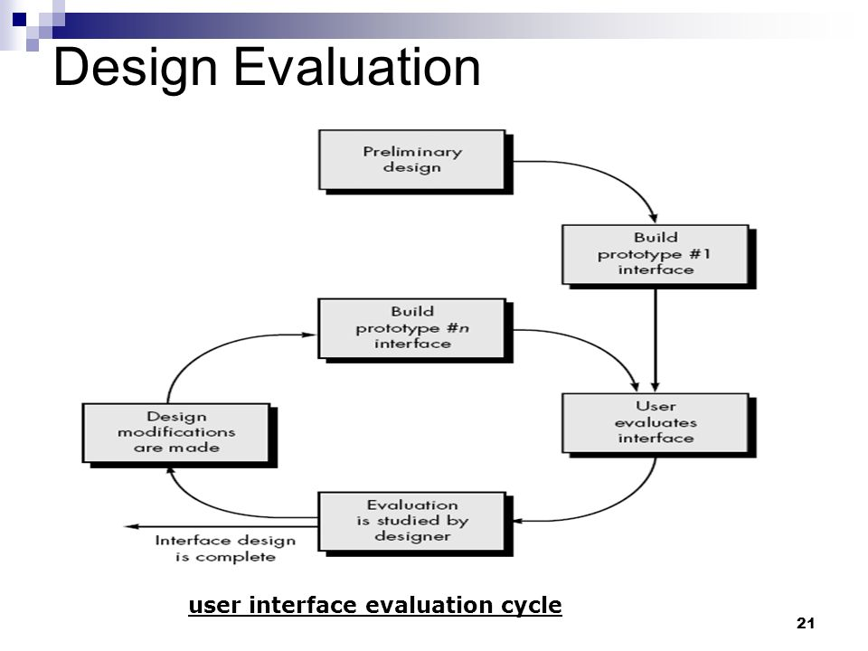

Slide 27
Background
Interface design focuses on the following
The design of interfaces between software components
The design of interfaces between the software and other nonhuman producers and consumers of information
The design of the interface between a human and the computer
Graphical user interfaces (GUIs) have helped to eliminate many of the most horrific interface problems
However, some are still difficult to learn, hard to use, confusing, counterintuitive, unforgiving, and frustrating
User interface analysis and design has to do with the study of people and how they relate to technology

Slide 28
A Spiral Process
User interface development follows a spiral process
Interface analysis (user, task and environment analysis)
Focuses on the profile of the users who will interact with the system
Concentrates on users, tasks, content and work environment
Interface design
Defines a set of interface objects and actions (and their screen representations) that enable a user to perform all defined tasks in a manner that meets every usability goal defined for the system

Slide 29
Interface construction
Begins with a prototype that enables usage scenarios to be evaluated
Continues with development tools to complete the construction
Interface validation, focuses on
The ability of the interface to implement every user task correctly, to accommodate all task variations, and to achieve all general user requirements

Slide 30
The Rules of User Interface Design

Slide 31
Place the User in Control
Define interaction modes in a way that does not force a user into unnecessary or undesired actions
The user shall be able to enter and exit a mode with little or no effort (e.g., spell check → edit text → spell check)
Provide for flexible interaction
The user shall be able to perform the same action via keyboard commands, mouse movement or voice recognition
Allow user interaction to be interruptible and "undo“ able
The user shall be able to easily interrupt a sequence of actions to do something else (without losing the work that has been done so far)
The user shall be able to "undo" any action

Slide 32
Place the User in Control
Streamline interaction as skill levels advance and allow the interaction to be customized
The user shall be able to use a macro mechanism to perform a sequence of repeated interactions and to customize the interface
Hide technical internals from the casual user
The user shall not be required to directly use operating system, file management, networking. etc., commands to perform any actions. Instead, these operations shall be hidden from the user and performed "behind the scenes" in the form of a real-world abstraction
Design for direct interaction with objects that appear on the screen
The user shall be able to manipulate objects on the screen in a manner similar to what would occur if the object were a physical thing (e.g., stretch a rectangle, press a button, move a slider)

